Slide 1
2025/09/30 Meeting Report

Slide 2
目前進度
Few shot Learning
  正在從 train_split 挑例子 (目前已完成 NoInterest、Depressed、Sleep)
挑選的 PHQ8 NoInterest example
  Score = 0
    Interviewer: what are some things you like to do for fun?
    Participant: uh fun i, like going to the beach uh, i love shooting darts but i haven't done it in a while i i love i love to paint uh i got into watercolor painting, and i'm pretty gifted at that ... i love fishing, i really really enjoyed it.
  Score = 1
    Interviewer: how have you been feeling lately?
    Participant: uh, just uh feeling tired and sluggish and um less less motivated and less interested in things.
Notes:
一般 learning rate 都會根據 batch size 做一些 scale 的操作。這裏用的是lr x batch_size / 256」。
Learning rate 小 under-fitting
Learning rate 大 unstable

Slide 3
目前進度
挑選的 PHQ8 NoInterest example
  Score = 2
    Interviewer: what were your symptoms?
    Participant: well you know i was, always tired and, not excited about things anymore and, kinda lethargic you know laying around and, just not feeling myself.
    Interviewer: how have you been feeling lately? Participant: mm about the same.
  Score = 3
    Interviewer: how have you been feeling lately? Participant: tired sad depressed blue.
    Interviewer: have you noticed any changes in your behavior or thoughts lately? Participant: no i'm just not happy i don't feel good and i'm not happy.
    Interviewer: how do you cope with them? Participant: i stay <st> don't just stay stay to myself don't go out with friends as much as i used to, it's very hard.
    Interviewer: what sort of changes have you noticed since you've been going to therapy? Participant: well not that many changes <cha> i still don't feel that great but i just it's good to talk to someone and tell them how you feel, even if it's just to get something off your chest.
Notes:
一般 learning rate 都會根據 batch size 做一些 scale 的操作。這裏用的是lr x batch_size / 256」。
Learning rate 小 under-fitting
Learning rate 大 unstable

Slide 4
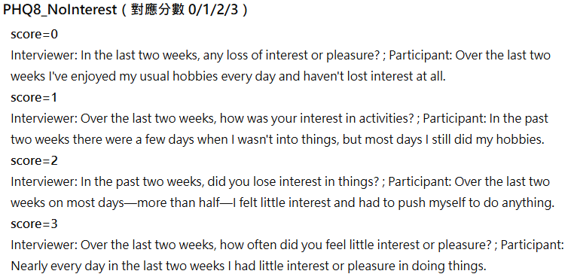
目前進度
Few shot Learning
  設計一組虛擬例子做 few shot (目前正在跑)
Notes:
一般 learning rate 都會根據 batch size 做一些 scale 的操作。這裏用的是lr x batch_size / 256」。
Learning rate 小 under-fitting
Learning rate 大 unstable

Slide 5
後續實驗
比較 “zero shot 讓模型一次判斷 8 種症狀分數” 與
“zero shot 分8次prompt，讓模型一次判斷一種症狀分數”
Notes:
一般 learning rate 都會根據 batch size 做一些 scale 的操作。這裏用的是lr x batch_size / 256」。
Learning rate 小 under-fitting
Learning rate 大 unstable

Slide 6
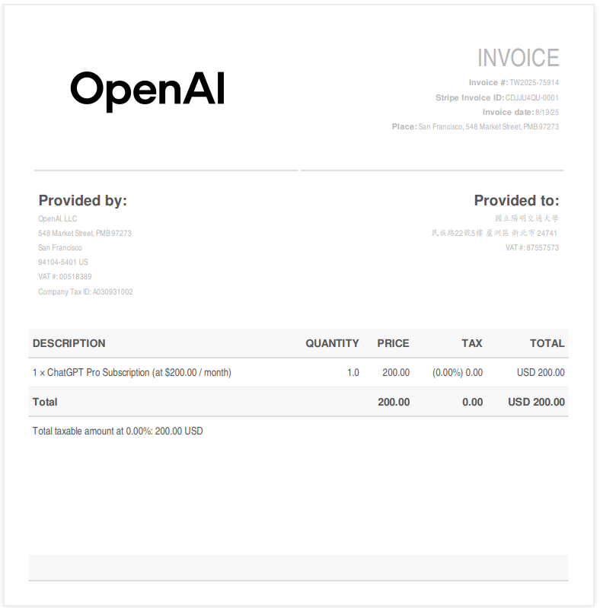
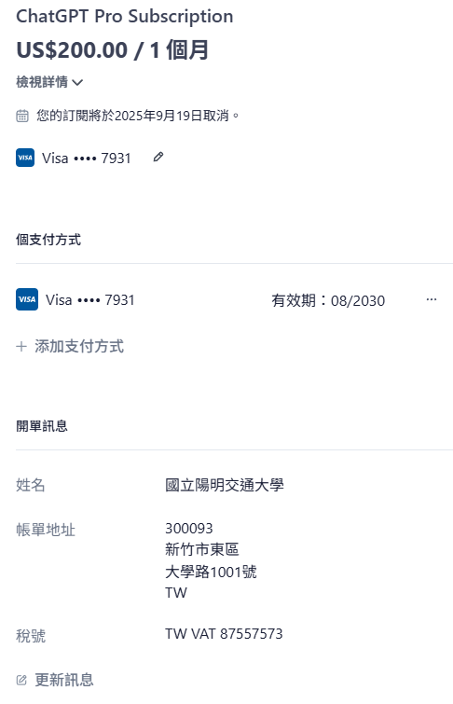
是否能請款
Notes:
一般 learning rate 都會根據 batch size 做一些 scale 的操作。這裏用的是lr x batch_size / 256」。
Learning rate 小 under-fitting
Learning rate 大 unstable

